Slide 1


Loan Repayment Prediction : Case Study
www.learnbay.co

Slide 2

Problem Statement
Build a credit score using Machine Learning and that indicates the likelihood of loan repayment

Slide 3
Credit Scoring – What , Why & How
What : Methodology leveraged by Financial Institutions to determine the risk of non payment associated with loans
Why is it used?
How is it used?
Credit Scoring enables decision making at all customer lifecycle stages
Removes the need to manually examine each loan customer
Clear understanding of Denial or Approval reasons leading to sound business approach
Credit Scores are used to determine the following areas under Loan portfolios
Approval – Should the Loan be approved?
Pricing – What is the right Interest ?
Cross Sell – Can we sell another loan ?
Refinance – Should there be a change in Interest?

Slide 4
Scorecards – How to they look like ?
Scorecards are deployed to take Model Driven decisions in an intuitive manner
Why is it used?
Steps to build a Scorecard
Variable | Value Bucket | Scorecard Point
AGE | <22 | 100
AGE | 22<=AGE<26 | 120
AGE | 26<=AGE<29 | 185
AGE | 29<=AGE<32 | 200
AGE | 32<=AGE<36 | 210
AGE | 36<=AGE<42 | 225
AGE | >=42 | 250
HOME STATUS | OWN | 225
HOME STATUS | RENT | 110
INCOME | <10000 | 120
INCOME | 10000<=INCOME<17000 | 140
INCOME | 17000<=INCOME<25000 | 180
INCOME | 25000<=INCOME<35000 | 200
INCOME | 35000<=INCOME<58000 | 225
INCOME | 58000<=INCOME<100000 | 230
Exploratory Data Analysis
Variable Discretization
WOE Substitution and IV Screening
Model Fitting and Validation
Score Scaling from Model Parameters
Drive Decisions through Scores

Slide 5
Dataset and Description
VARIABLE | DESCRIPTION
Application | The month which the loan was funded
 | The number of payments on the loan. Values are in months and can be either 36 or 60.
Bureau | The number of inquiries in past 6 months (excluding auto and mortgage inquiries)
 | The total number of credit lines currently in the borrower's credit file
Collections | Number of collections in 12 months excluding medical collections
 | post charge off collection fee
Credit Line | The listed amount of the loan applied for by the borrower. If at some point in time, the credit department reduces the loan amount, then it will be reflected in this value.
 | The month the borrower's earliest reported credit line was opened
Deliquency | The number of 30+ days past-due incidences of delinquency in the borrower's credit file for the past 2 years
 | The number of months since the borrower's last delinquency.
Demographics | The home ownership status provided by the borrower during registration. Our values are: RENT, OWN, MORTGAGE, OTHER.
 | The state provided by the borrower in the loan application
Employment | Employment length in years. Possible values are between 0 and 10 where 0 means less than one year and 10 means ten or more years.
 | The job title supplied by the Borrower when applying for the loan.*
Income | Indicates if income was verified by LC, not verified, or if the income source was verified
 | The combined self-reported annual income provided by the co-borrowers during registration
Outstanding | Remaining outstanding principal for portion of total amount funded by investors
 | Remaining outstanding principal for total amount funded
Payment | Last total payment amount received
 | Next scheduled payment date
Pricing | Interest Rate on the loan
 | Interest received to date
Risk Score | The lower boundary range the borrower’s FICO at loan origination belongs to.
 | The lower boundary range the borrower’s last FICO pulled belongs to.
Risky Behavior | Revolving line utilization rate, or the amount of credit the borrower is using relative to all available revolving credit.
 | Total credit revolving balance
Status of Loan (Dependent) | Status of Loan

Slide 6
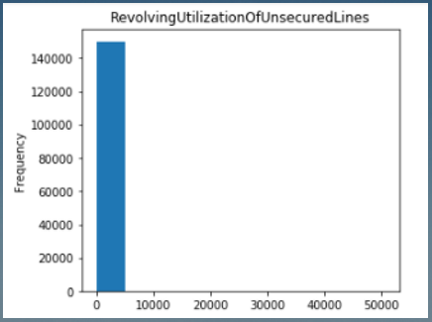
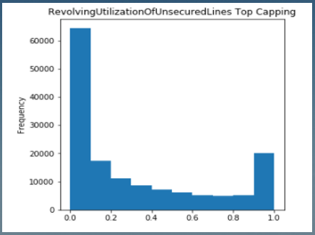
Exploratory Data Analysis
Defining Dependent Variable and Cleaning of Independent Variables
Check for variability in the data. Lack of variability reduces the explanatory power over dependent variable
Treating of outliers : Flooring and Capping
Missing Value Imputation Methods :
Central Tendency (Replace with Median – Continuous)
Central Tendency (Replace with Mode for Character)
Class Mean Substitution (Replace with closet Bin Mean)
Example of Outlier Treatment

Slide 7

Binning and Discretization
What is the nature of Bivariate Relationship of variables
Create buckets of independent variables based on ranking methods
This process allows us to understand feature performance better
The insights from this part of the analysis can be useful in devising portfolio risk strategies
Example of Binning Method
Capped_Age | Cappped_Age_Bin
21 | A:0-22
23 | A:22-26
27 | A:26-29
28 | A:29-32
33 | A:32-36
34 | A:36-42
60 | A:42+
Import pandas as pd
df [‘var_bin’]=pd.qcut(df[‘var’].rank(method=‘first’).values,10,duplicates=‘drop’).codes+1
df.groupby(‘var_bin’)[‘Dependent’].mean()

Slide 8
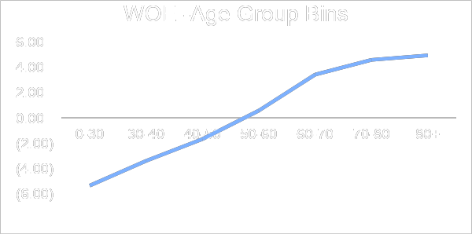
Weight of Evidence Substitution
Weight of Evidence is used for substituting in place of categorical values for Variable Bins
Calculation Logic
Uses and Interpretation
100
WOE measures the strength of a bin in differentiating the Good and Bad accounts
WOE values are substituted in place of the Bin Labels across variables
WOE <0 indicates that the variable bin is captures higher proportion of bad accounts
The overall trends for WOE across should be logical and we should ideally observe a monotonic trend
WOE = Ln Distribution of Good Cases
Distribution of Bad Cases

Slide 9
Information Value of Variables
Information value is the measure of overall predictive power of the variables and is very useful for feature selection
Calculation Logic
Example (WOE & IV)
WOE
Age Bins | Obs Count | Bad | Good | Bad Distribution | Good Distribution | WOE | IV
0-30 | 10,758 | 1,244 | 9,514 | 7% | 7% | -5.36 | 0.02
30-40 | 24,339 | 2,390 | 21,949 | 16% | 16% | -3.4 | 0.02
40-50 | 35,037 | 2,893 | 32,144 | 23% | 23% | -1.68 | 0.01
50-60 | 34,806 | 2,149 | 32,657 | 23% | 23% | 0.56 | 0
60-70 | 27,424 | 952 | 26,472 | 18% | 19% | 3.4 | 0.02
70-80 | 12,700 | 298 | 12,402 | 8% | 9% | 4.56 | 0.02
80+ | 4,447 | 89 | 4,358 | 3% | 3% | 4.91 | 0.01
IV = Sum (Good Case % - Bad Case %)
IV
Predictive Power
IV =0.09
<0.02 | Not Useful
0.02 to 0.1 | Weak Predictor
0.1 to 0.3 | Medium Predictor
0.3 to 0.5 | Strong Predictor
>0.5 | Suspicious

Slide 10

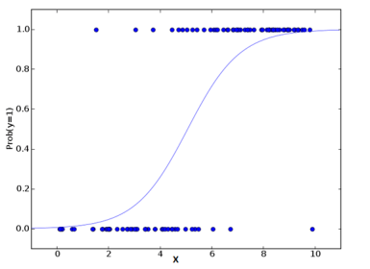
Model Fitting on prepared data
Parametric Approach : Logistic Regression Classifier to be used to fit the training data and model to be finalized post iterations
Logistic Regression Model
Model Structure
Dependent Variable – Categorical (Good/Bad)
Relates Log of Odds to a Linear Combination of Predictors
Final model have statistically significant predictors
LR Coefficients to be estimated from the training data to be used for developing Scorecard
The Scores are further scaled to fall within a certain range of values
Predicted Probabilities Describe a Sigmoidal Curve

Slide 11


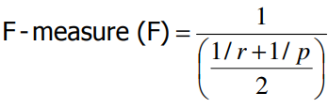
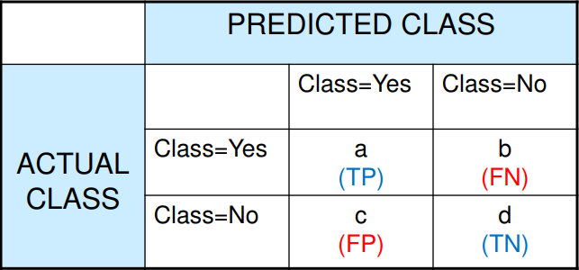


How to Measure Classification Performance
Accuracy
Precision
Recall
F Score
Confusion Matrix

Slide 12



Score Scaling
Scores for each variable bin is calculated as follows
Score =
*
WOE
N
*
Factor
Offset /N
Where
Logistic Regression coefficient of the variable
Logistic Regression Intercept
N Number of Variables in the Model
Factor Points to double the odds / Ln (2)
Offset Score – { Factor * ln (Odds) }
We choose to scale the points such that a total score of 600 points corresponds to good/bad odds of 50 to 1
An increase of the score of 20 points corresponds to a doubling of the good/bad odds.
Factor – 20/ln(2) = 28.85
Offset – 600 – 28.85 * Ln (50) = 28.85

Slide 13
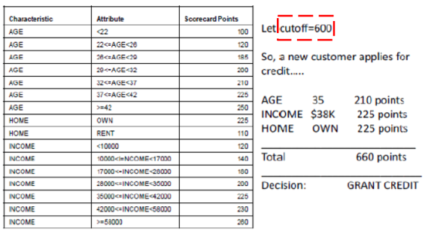
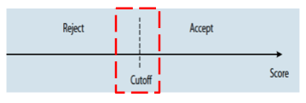
Decision Making from Scorecard
Considerations for Score Usage
An Example
Choosing a score cut off that is appropriate for the Loan Product
For Example : Secured Loans may be approved for a lower score than unsecured loans
Scores not only are used for assessment but also for predictive purposes
The Model scores combined with business considerations are used for final decision making

Slide 14
Data Set Link
https://www.kaggle.com/wendykan/lending-club-loan-data
Loan Data (887K x 75)

Slide 15

THANK YOU!
Aritra Kumar Sinha
Phone
+91 9650444155
Email
aritrakumar.sinha@gmail.com

